Slide 1
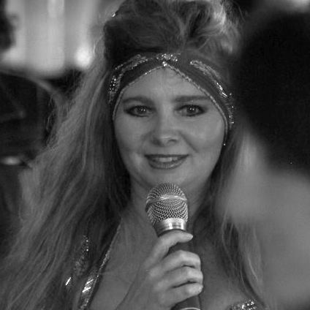


#bodyforbrains Your Body, Your Magnificence, Your Brain! Your Hidden Genius Super Power is your Magical Unicorn Your Body does not lie!
Charlotte D Blignaut

Slide 2
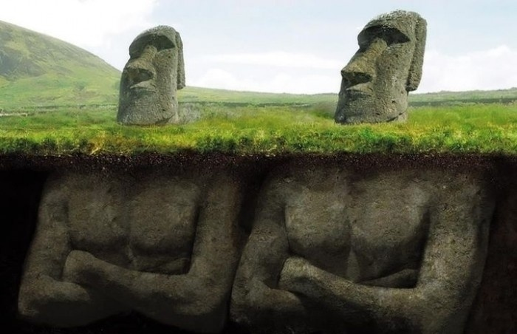


#Body4Brains
Your Body Does not Lie

Slide 3
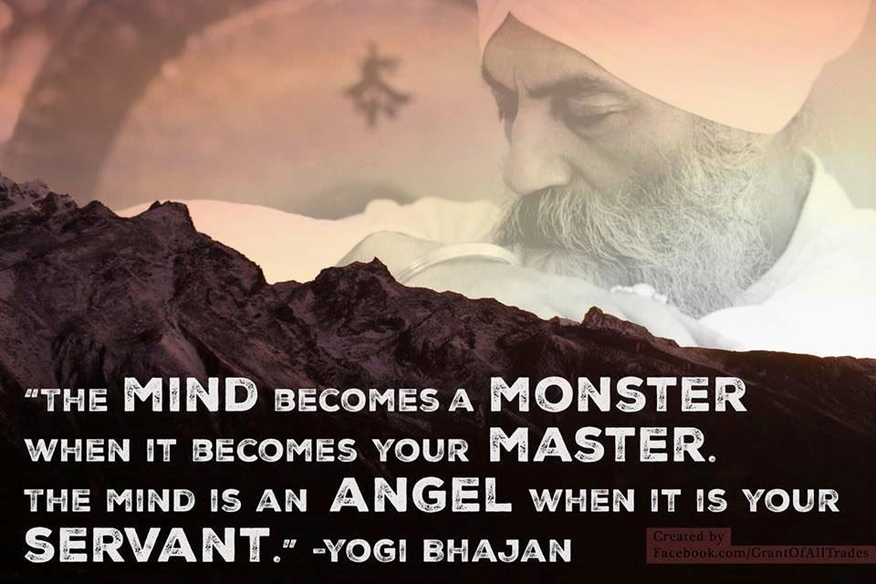

Slide 4
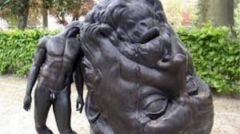
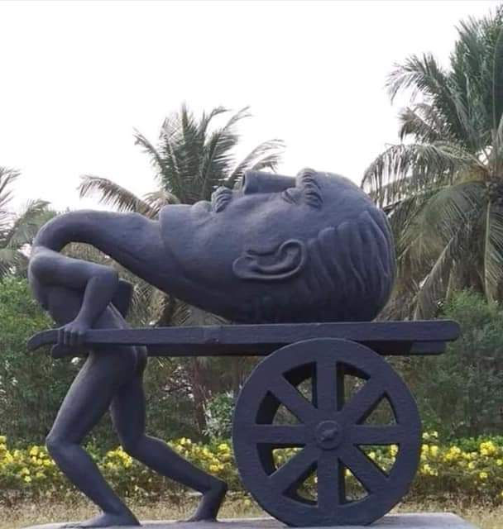

Slide 5
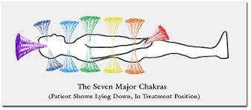
Energy Centre or Chakras
Your Shields of Info & Protection
Breathe into each, with Intentional Mindfulness

Slide 6
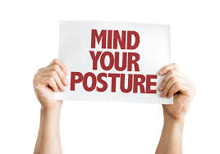
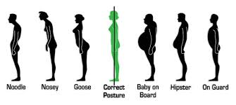

Slide 7


Root

Slide 8

Root

Slide 9
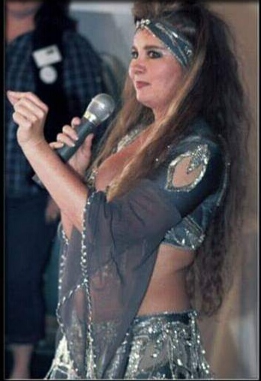
Sacral/Navel

Slide 10

Sacral/Navel

Slide 11
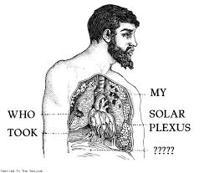
Solar Plexus

Slide 12

Solar Plexus

Slide 13

Your Heart - Voice of your Body

Slide 14

Heart

Slide 15

Throat

Slide 16

Throat

Slide 17
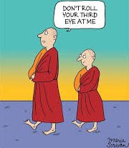
3rd Eye

Slide 18

3rd Eye

Slide 19
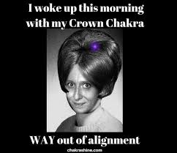
Crown

Slide 20

Crown

Slide 21
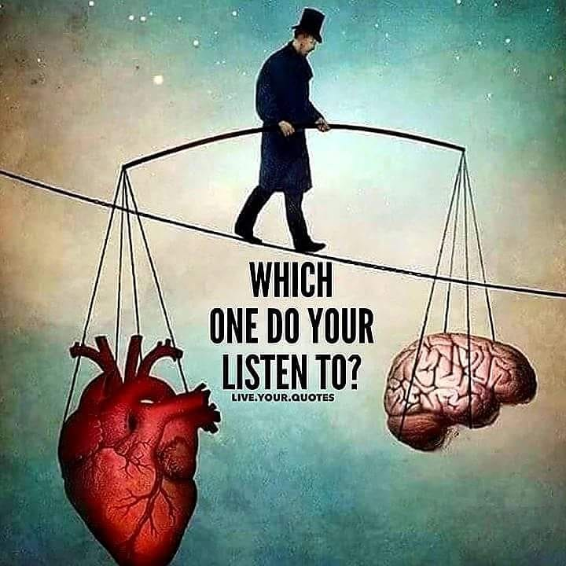
www.charlottedblignaut.co.za
#body4brains @body4brains #inspire2transform @inspire2transform
#YourHiddenGeniusSuperPower
is your Magical Unicorn, Your Body does not lie.

